Slide 1
Analysis On Airline Data

Slide 2
Introduction:
An airline dataset is a comprehensive collection of structured data related to the operations of airlines, flights, and associated elements. It includes essential information such as flight numbers, departure and arrival airports, scheduled and actual timings, flight duration, distance, delays, and cancellations. Details about airlines encompass unique codes, full names, and contact information. Airport data provides identifiers, names, geographic coordinates, cities, and countries. Passenger data includes unique identifiers, full names, and ticket-related information like class and price. Route data consists of identifiers, source and destination airports, and the operating airline. Additionally, weather data may be included, specifying conditions at departure and arrival airports. Aircraft data may detail aircraft types and capacities.
This dataset is valuable for various analytical purposes within the airline industry, enabling analyses of flight patterns, operational optimizations, delay predictions, and insights into passenger behaviors. Researchers, analysts, and stakeholders leverage this data to enhance airline services, improve travel experiences, and make informed decisions, ultimately contributing to the efficiency and effectiveness of the airline industry as a whole.

Slide 3
Problem Statements:
To determine which age group travels the most in airlines?
To discover which gender travels the most in airlines?
To compare Arrival Delay in Minutes vs. Departure Delay in Minutes?
To locate the satisfaction indicator across all airlines?
To find Correlation in order to find a balanced distribution?
To determine gender vs. customer satisfaction?

Slide 4
Data Architecture:
Raw Dataset
The Netflix dataset's accurate data to locate and extract.
Data Cleaning And Transformation
Split the dataset into training and testing sets. And applying the models to retrieve valuable solutions to Problem Statements
The Netflix dataset
a to locate and extract.
Data Visualization

Slide 5
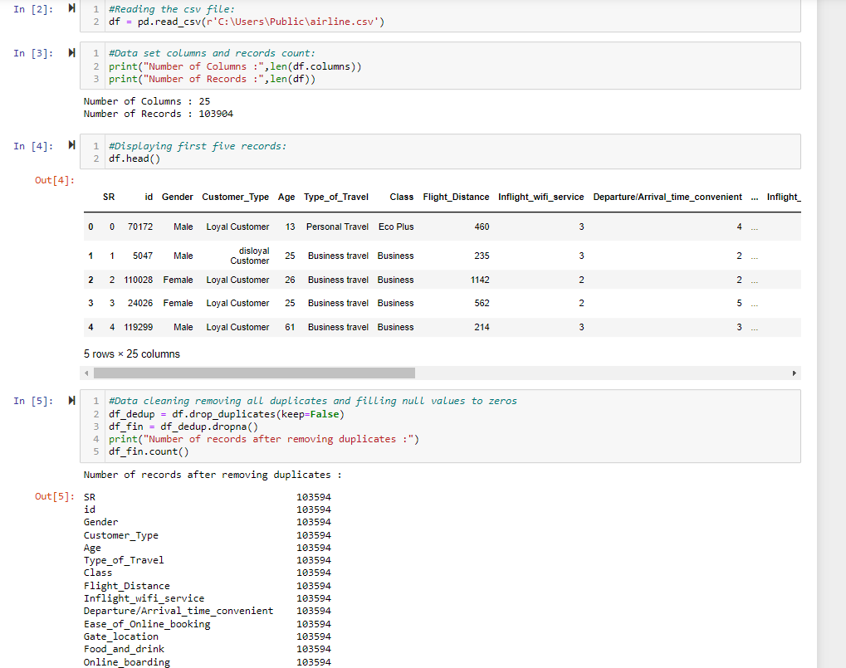
Data Transformation:

Slide 6
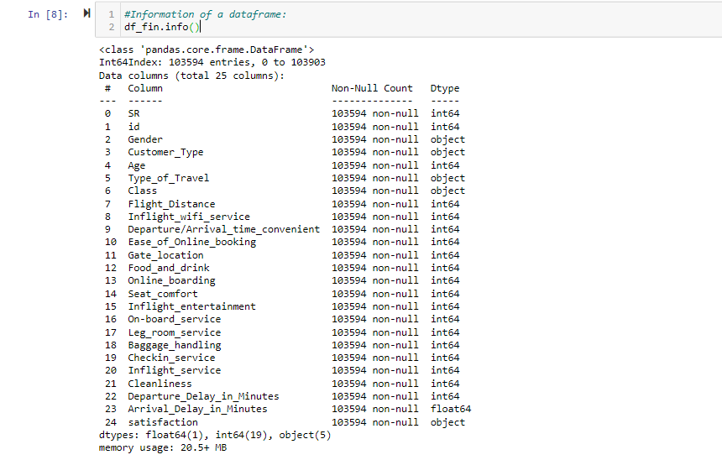
Dataset Information:

Slide 7
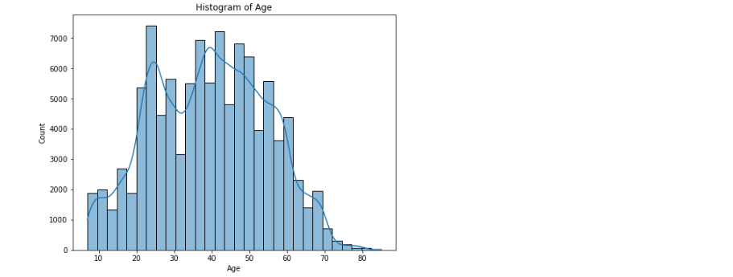
To determine which age group travels the most in airlines:

Slide 8
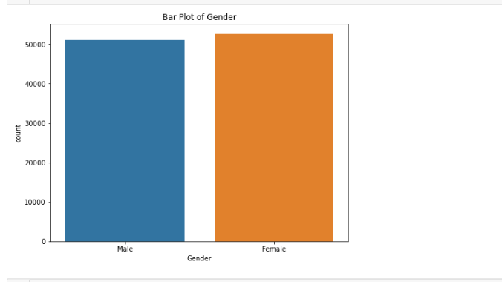
To discover which gender travels the most in airlines:

Slide 9
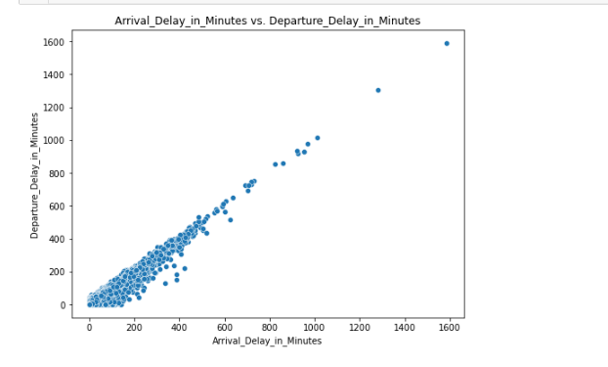
Arrival Delay in Minutes vs. Departure Delay in Minutes:

Slide 10
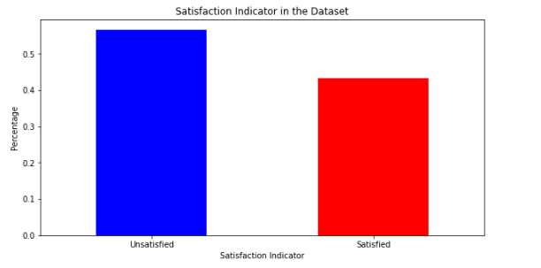
Satisfaction indicator across all airlines:

Slide 11
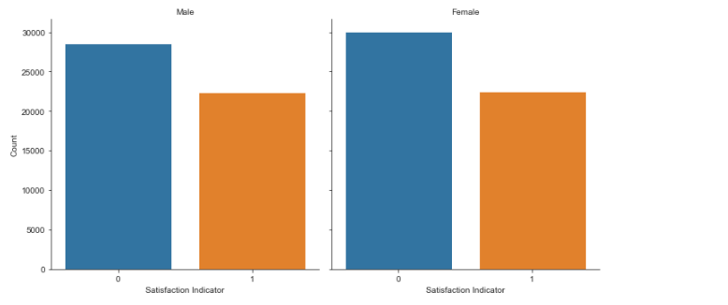
gender vs customer satisfaction:

Slide 12
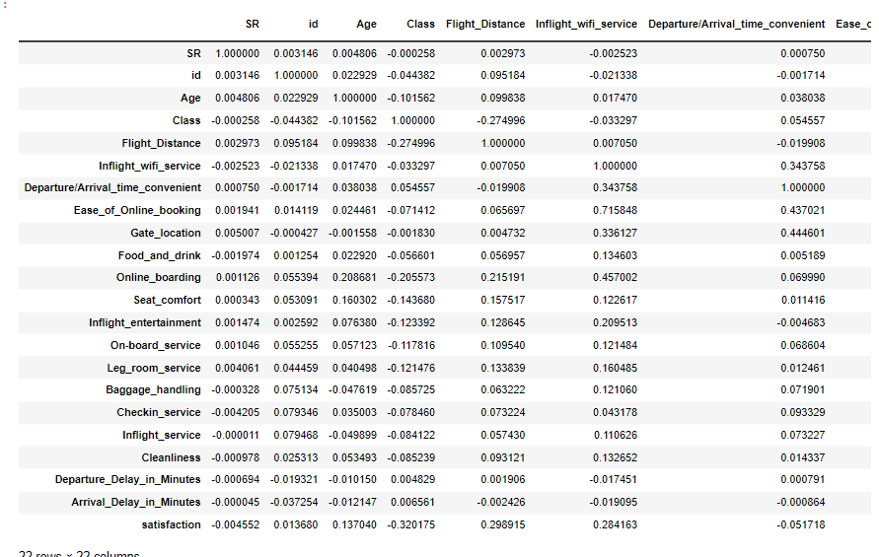
Correlation to find balanced distribution:

Slide 13
Thank You

